Slide 1
The Gaia Group

Slide 2






Vehicle Insurance Customer
By : Gaia Group

Slide 3
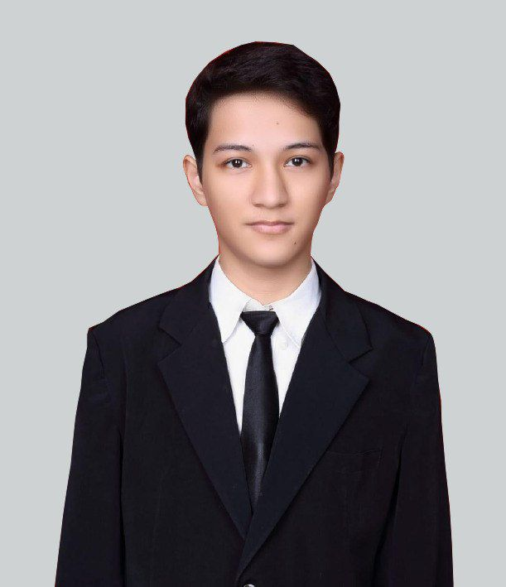


The Team Member
Abdul Kadir Syahab
Alaniah Nisrina
Farhan Guido Haryadi

Slide 4
The Outline
01
The Problem Formulation
03
The Finding & The Solution
02
The Data Understanding
04
The Conclusion & The Recommendation

Slide 5
The Problem Formulation

Slide 6




The Context
An auto insurance company based on West Coast of United States want to know (predict) their customer based on their response (Yes/No). The response itself given by company based on the suitable between the customer’s behaviour and the preliminary of auto insurance. Surely the company want to make an effective marketing strategies (make many of Yes response)
The Problem
Ineffective Marketing-way
Wasting Time
Wasting Money
Can’t decide the target markets
Don’t know the customer behaviour
Strong enough of the No response
Deficient Market Research

Slide 7



The Goals
Effective Marketing-way
Predict The Customer
Saving Money, More Income
Analyze the customer behaviour through the yes response to getting the effective marketing-way
Create a machine learning with good performance to predict the customer
Create the best model of machine learning through the evaluation metric to making more profit and income
The Analytic Approach
Based on the given issues, we will use machine learning technique to help the company especially for the marketing teams as a stakeholder.
To achieve our goal, we conducted these approaches:
Creating an EDA process, visualize important aspects, findings of the data and give a solution
Applying machine learning classification technique to predict the target

Slide 8
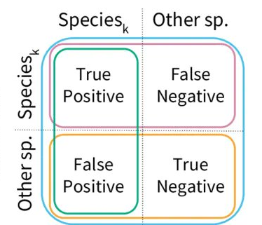


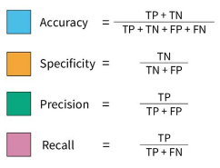
The Target & The Evaluation Metric
Prediction
Target
P
N
Target of this machine learning is the Response of Yes (1) & No (0)
P
Actual
Evaluation Metric
N
Evaluation Metric that will be implemented are Recall and Accuracy
Why?
Because we want to know the True Positive Rate of Model-Machine Learning we build & All the True probability of Model-Machine Learning.

Slide 9
The Data Understanding

Slide 10
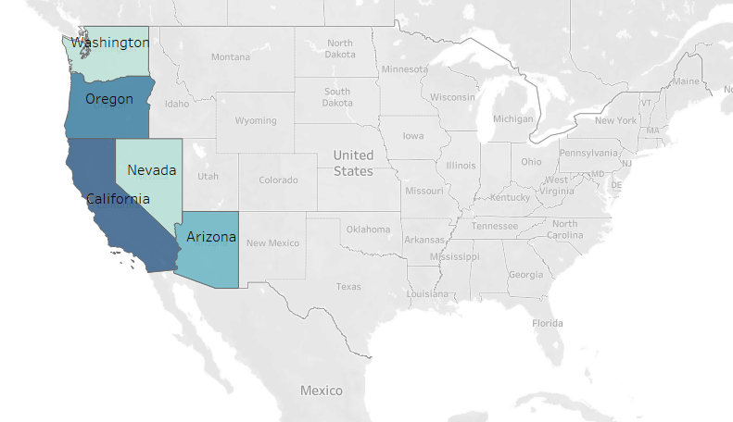


The data source is from one of vehicle insurance company that based on West Coast of United States in 2011.
24 columns, 9134 rows
Variable Target :
Response
Nominal, Ordinary, Binary
No duplicated data,
No missing value
Data Source : https://www.kaggle.com/datasets/ranja7/vehicle-insurance-customer-data

Slide 11
The Finding & The Solution

Slide 12
The Exploratory Data Analysis
The Finding & The Solution

Slide 13
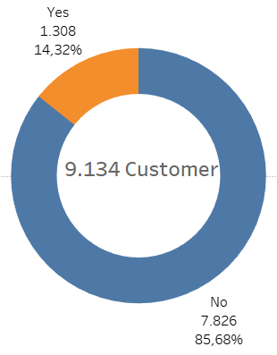
In The General
In general, the company given 1308 (14.32%) Yes Response from 9134 candidates customer in 2011
Many of candidate customer is unsuitable with the preliminary of vehicle insurance

Slide 14
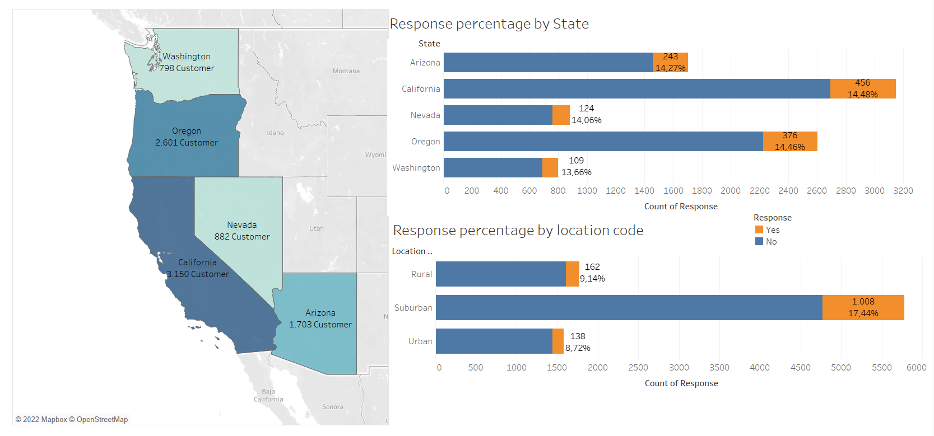
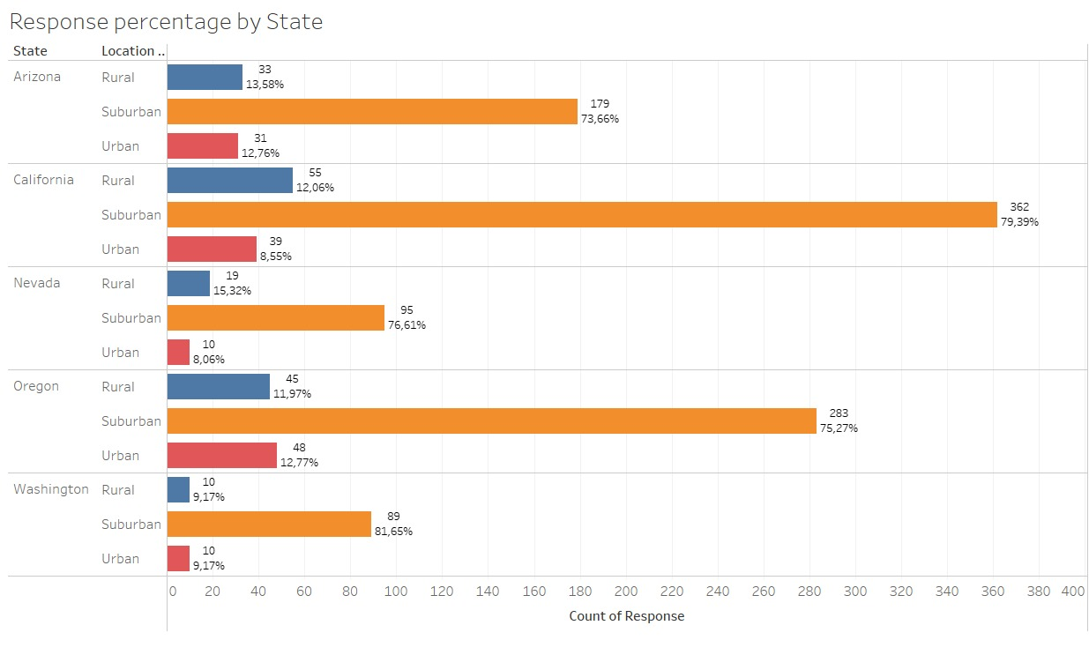

Dive In (Demography)
Suburban area
Rural vs Urban area
had the most yes percentage area in each region on West Coast of United States in 2011
Rural area likely has more yes percentage than Urban, this might be because commonly vehicle incident in US is happened in Urban area

Slide 15
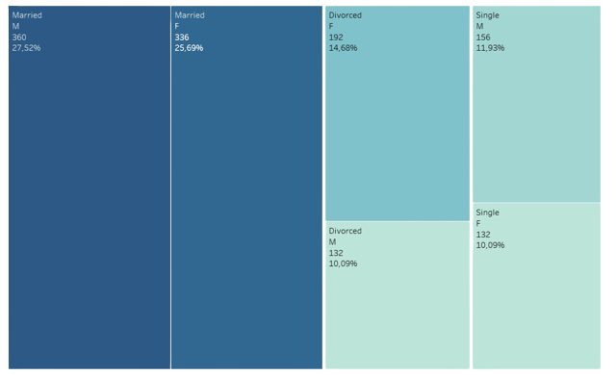
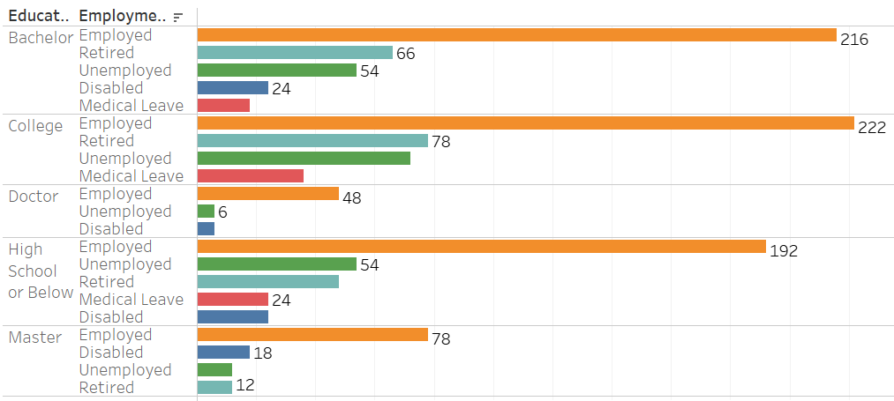
Dive In (Statuses)
Married status
Employed status
had the most yes percentage in each Gender & Marital Status of candidate customer
had the most yes in each Education & Employment status of candidate customer

Slide 16
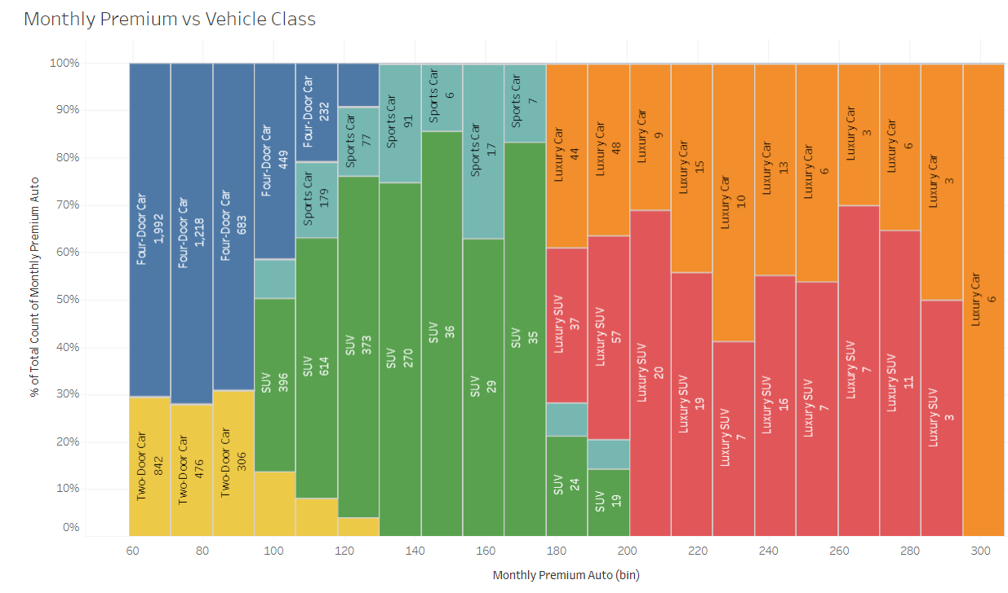
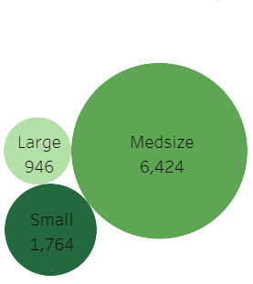
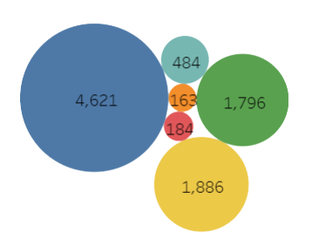
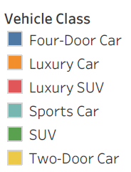
Dive In (Type of Car)
Vehicle Class
Vehicle Size
Four-Door & Medsize Car
Luxury Car
Had the most yes percentage in each type of car (Class & Size)
Most of Luxury Car & SUV had the big amount of Monthly Premium Auto

Slide 17
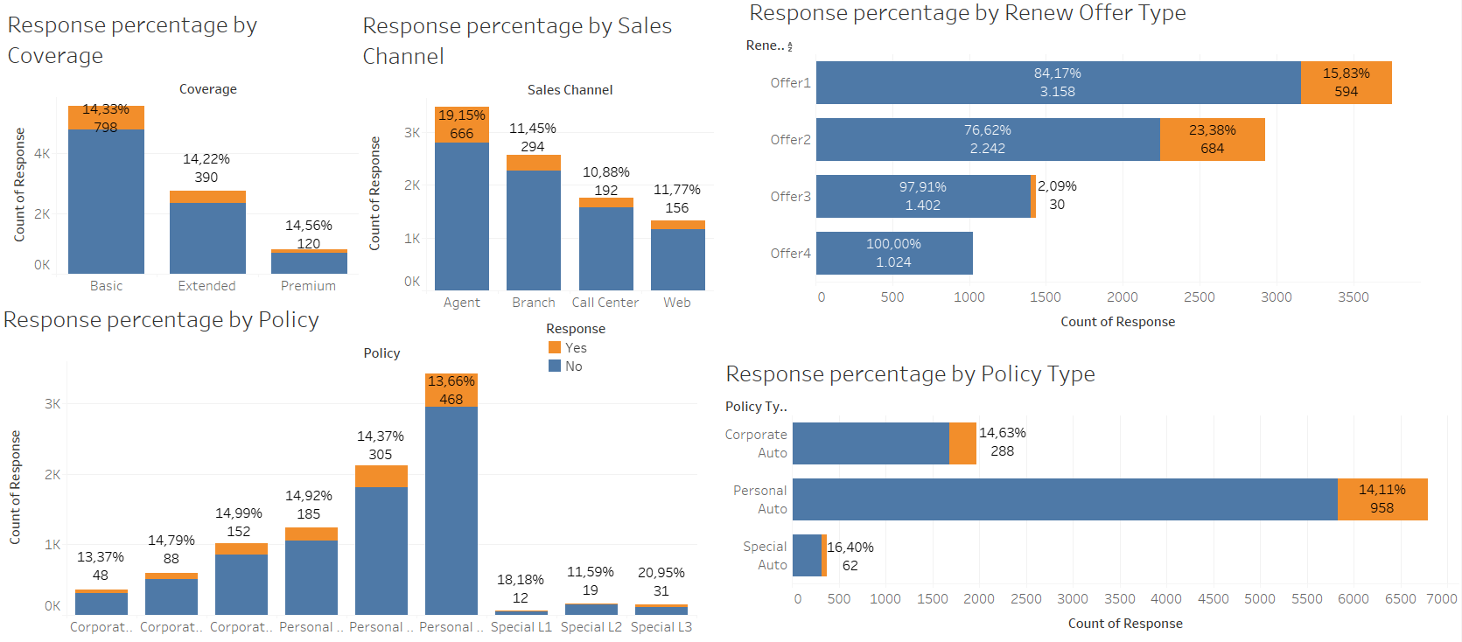
Dive In (Type of Marketing)
Agent Approach
Personal Auto
Offer 1 & 2
Had the most yes percentage in type of Sales Channel
Had the most yes percentage in type of Policy Type
Had the most yes percentage in type of Renew Offer

Slide 18
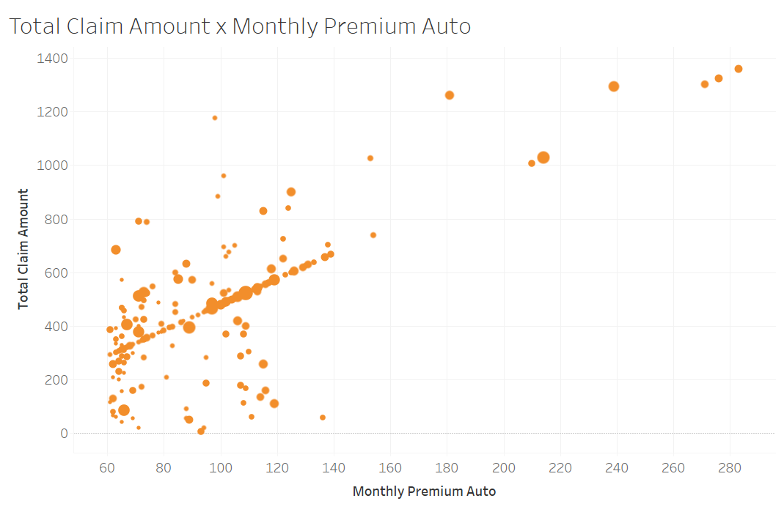
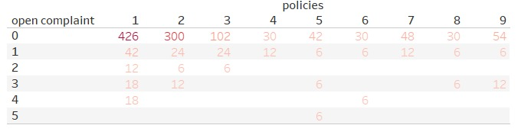
Dive In (Amount of)
Small Open Complaint
Small Monthly Premium & Total Claim
had the most amount of yes by company in each Customer’s Policies
had the most yes by company in each amount of Monthly Premium & Total Claim Amount

Slide 19

The Big Yes
Suburban
Area
Employed Customer
Basic Coverage Policy
Type Offer 2 & 1
Four-Door Car
Medsize Car
Yes
Agent
Sales Channel
Married Customer
Small Monthly Premium Auto Customer
Personal Auto
Policy
Small Open Complaints

Slide 20














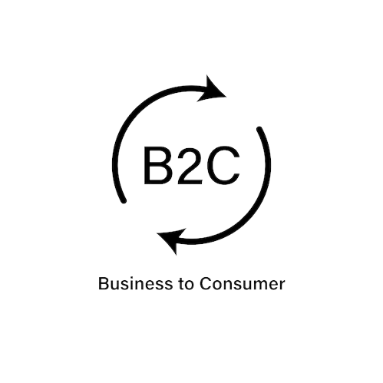

The Reason Why
Suburban
Area
Small Monthly Premium Auto Customer
Work Like Urban, Life Like Rural
Trusted, Small Risk
Married Customer
Small Open Complaints
Joint Income, More Stable
Profitable, Loveable
Employed Customer
Four-Door
&
Medsize Car
Earnings, More Safe
Common, Cheaper
Agent
Sales Channel
Personal Auto & Basic Coverage Policy
More Search, More Know
Large Market, Simple Plan

Slide 21
The Preprocessing
The Finding & The Solution

Slide 22


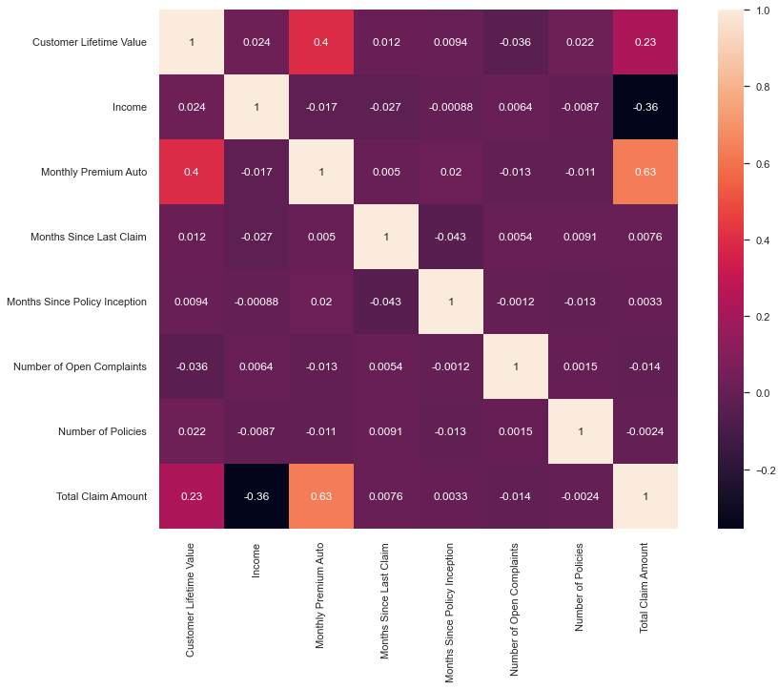
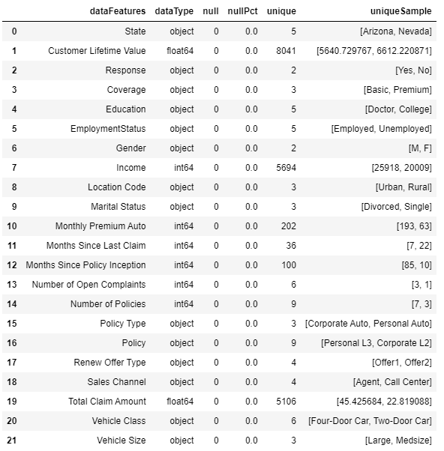
The Preprocessing (1)
Data Cleaning
Data Correlation
What to take out?
Customer ID
Effective to Date
Strong correlations :
- (0.63)
Moderate correlations :
- (0.4)
- (-0.36)

Slide 23

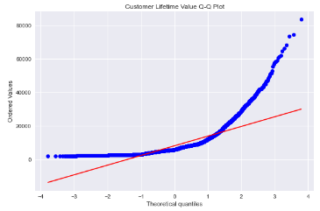
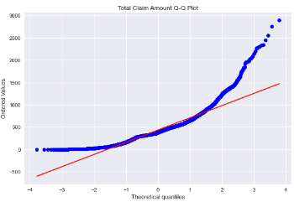
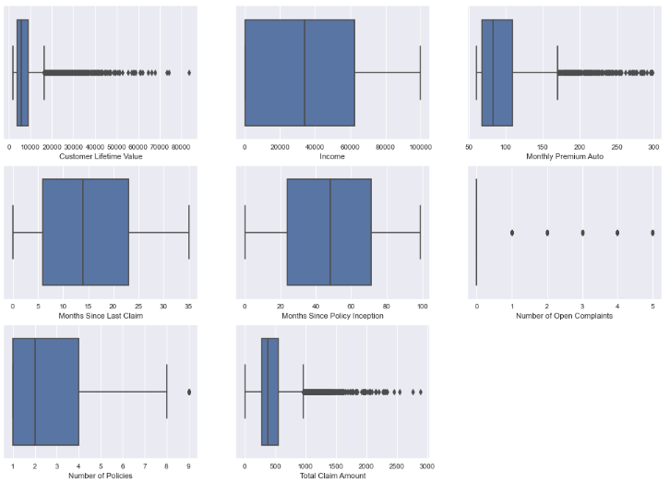


The Preprocessing (2)
Outlier Detection
Q-Q Plot
Deviation
Dive In
Extreme Value
The Normality Test
Shapiro-Wilk Test
Reject H0
Wilcoxon Rank-Sum Test
Support H0
The Suspect !
Customer Lifetime Value
Total Claim Amount
IT’S A GOOD OUTLIERS!

Slide 24



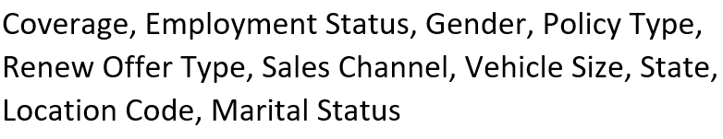
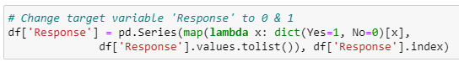
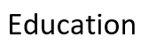
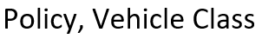
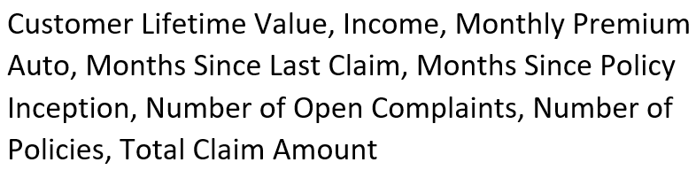
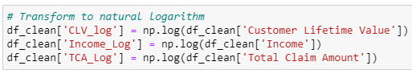
The Preprocessing (3)
Data Transformation
Data Transform
Why They Are?
One Hot Encoder
Change target Variabel to 0 & 1
One Hot Encoder
Simple encoding variables with values less than 5 unique values
Due to next step (Methodology)
. . .
Ordinal Encoder
Ordinal Encoder
For variables with an amount of degree in it’s values
. . .
Binary Encoder
Binary Encoder
Log-scaling ‘high numerical value’
For variables with more than 5 unique values
Due to next step (Standarscaler)
. . .
Robust Scaler
Robust Scaler
Scaler that suits data with outliers

Slide 25
The Methodology (Modeling/Analysis)
The Finding & The Solution

Slide 26
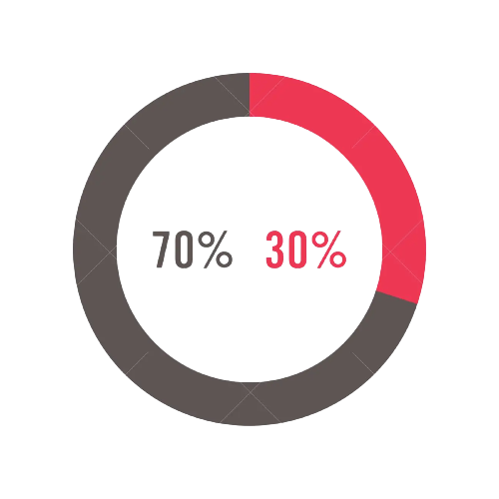
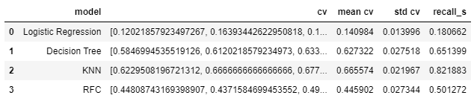
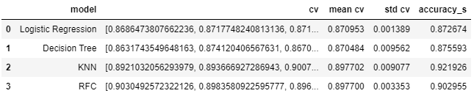
The Methodology
Data Splitting
Benchmark Model
Test Set
- Logistic Regression
- Decision Tree Classifier
- KNeighbors Classifier
- Random Forest Classifier
Train Set
Score with Recall
Score with Accuracy

Slide 27
Is it enough?

Slide 28
No,

Slide 29
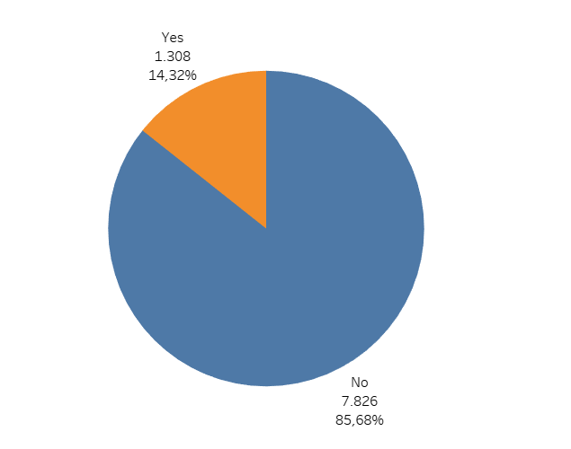
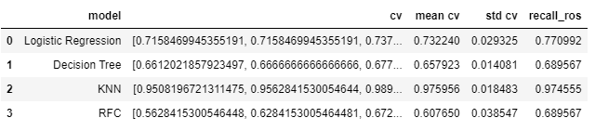
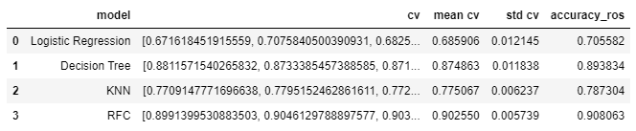
What We Do?
Handling Imbalance
Random Oversampling
Score with Recall
Score with Accuracy
Yes : 14,32%
No : 85,69%
KNN is the best!
Notes:
KNN dipilih karena nilai recall lebih penting sebagai metric utama

Slide 30
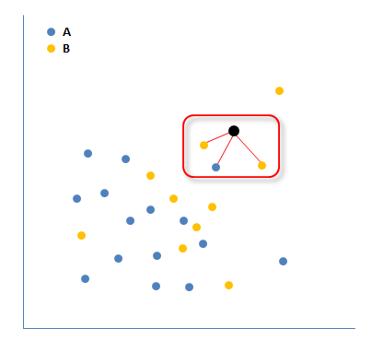

The Chosen Two
Random Oversampling
KNN
The Nearest Distance
Score with Recall
ADVANTAGES :
Score with Accuracy
More Stable
Keeping the original majority & minority class
No Information is Lost
Notes:
KNN dipilih karena nilai recall lebih penting sebagai metric utama

Slide 31
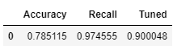
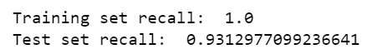
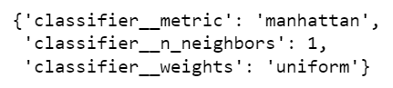
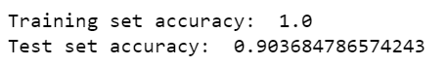
We Do This Too
Hyperparameter Tuning
ReTuned with Best Parameters
Score with Recall
Best Score
Score with Accuracy
Best Parameters
Notes:
KNN dipilih karena nilai recall lebih penting sebagai metric utama

Slide 32

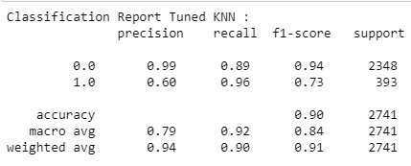
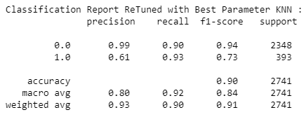
Comparing Report
Hyperparameter Tuning
ReTuned with Best Parameters
As we can see, with ReTuned with Best Parameters Model we can balancing the Recall’s Score. With this balancing score we will get the best impact with our business (reducing of wasting money).

Slide 33
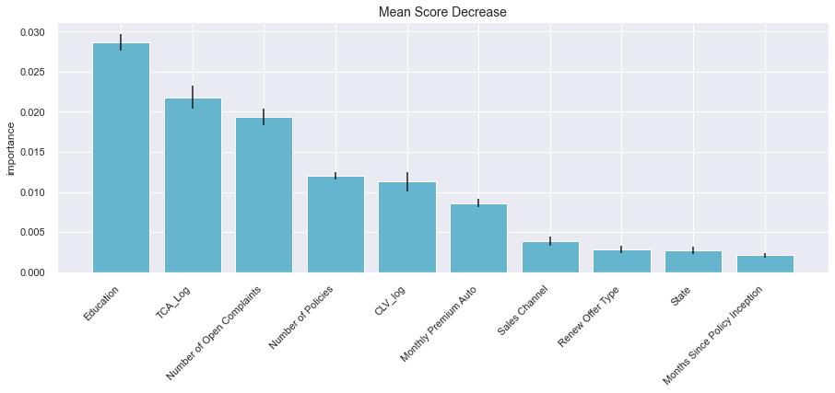
Feature Importance
Based on the graph, we can see that the feature importance of this model are Education, Total Claim Amount and Number of Open Complaints.

Slide 34
The Conclusion & The Recommendation

Slide 35
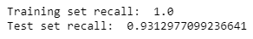

The Conclusion
The Best Model
Recall Score 0.931
ReTuned with Best Parameter KNN
Predict 93% Yes Response
Predict 90% No Response
61% Predict Yes Precision
99% Predict No Precision

Slide 36













The Recommendation
Business
Project Model
Make a Promo
Bundling Promo
Make a Clustering
More in Suburban
Extra in Urban & Rural
Another Type of Sampling
More in Personal
Review another Offer
Analyze More the Data
Make a Collaboration
Add More Feature
Notes:
Harus lebih tajam rekomendasinya

Slide 37
The Offer
Marketing Fee Simulation
Marketing cost = 1$ / person
Total Approaches = 200 persons
Without Model
Total Cost = 200 x 1$ = 200$
With Model
Total Cost = (93 x 1$) + (10 x 1$) = 103$
TP = 93 persons
FN = 7 persons
Wasted Cost = (10 x 1$) = 10$
Saving Cost = (90 x 1$) = 90$
45%
Savings!
90$
200$

Slide 38
Good Luck & Thank You

